Slide 1
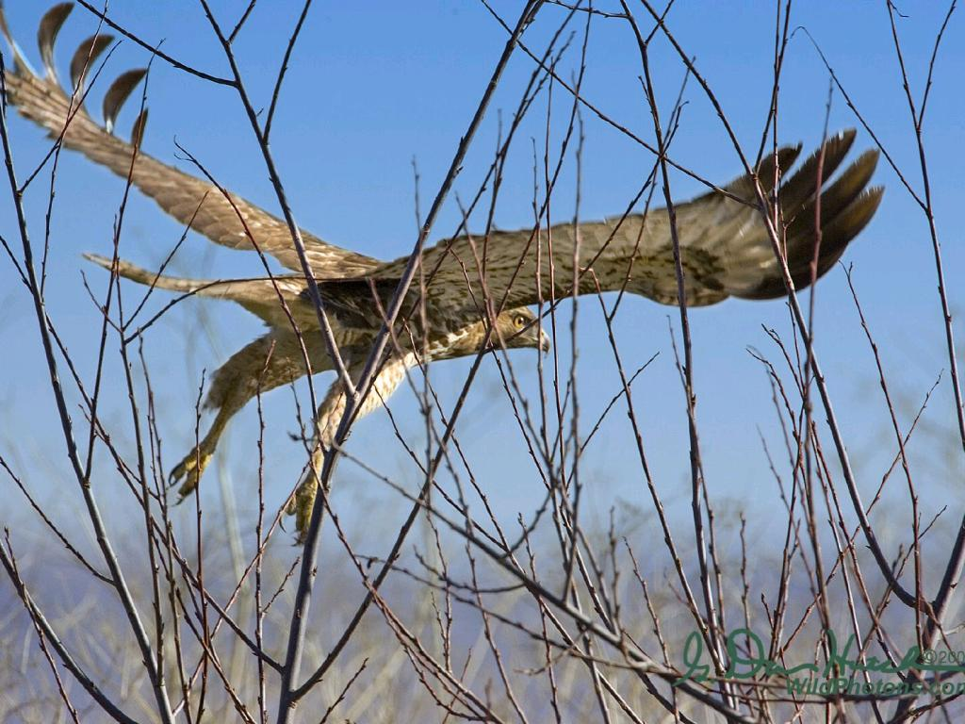
LEAVING THE NEST
2022

Slide 2
WE GAVE YOU A FILE
YOUR JOB IS TO FILL IT
Notes:
-Keep a file of all of your Graduation information
-Keep a file of all communication of your post-secondary communication

Slide 3
IT IS THE STUDENT'S RESPONSIBILITY
TO BE AWARE OF DUE DATES AND PRESENTATIONS
Notes:
-Review dates frequently
-Ask questions if you are not sure

Slide 4
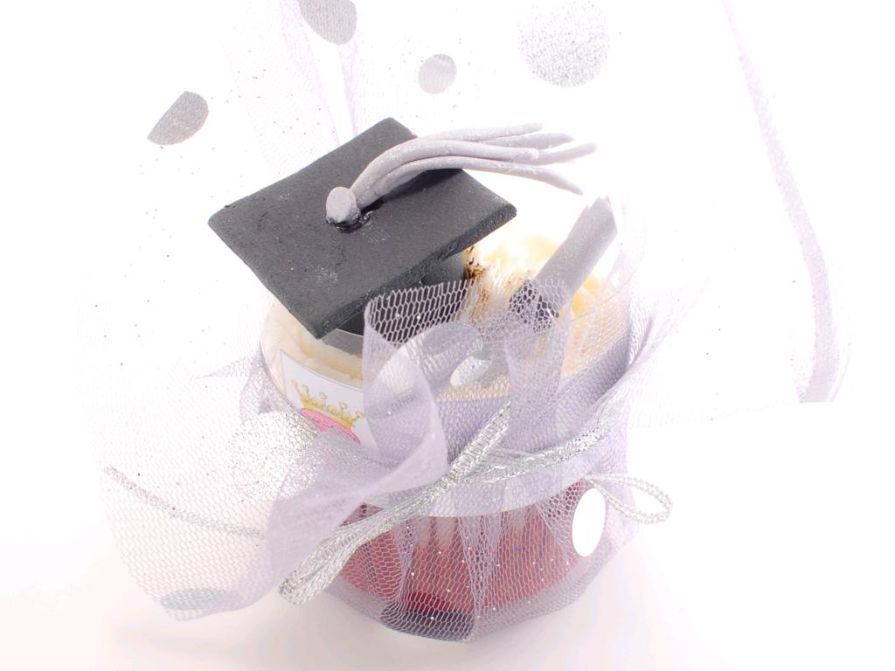
IT IS THE RESPONSIBILITY OF STUDENTS AND PARENTS
To make sure you have grad requirements
Notes:
-Review your status sheet and ask your counsellor if you are unsure if you need anything for Graduation

Slide 5
GRADUATION

Slide 6
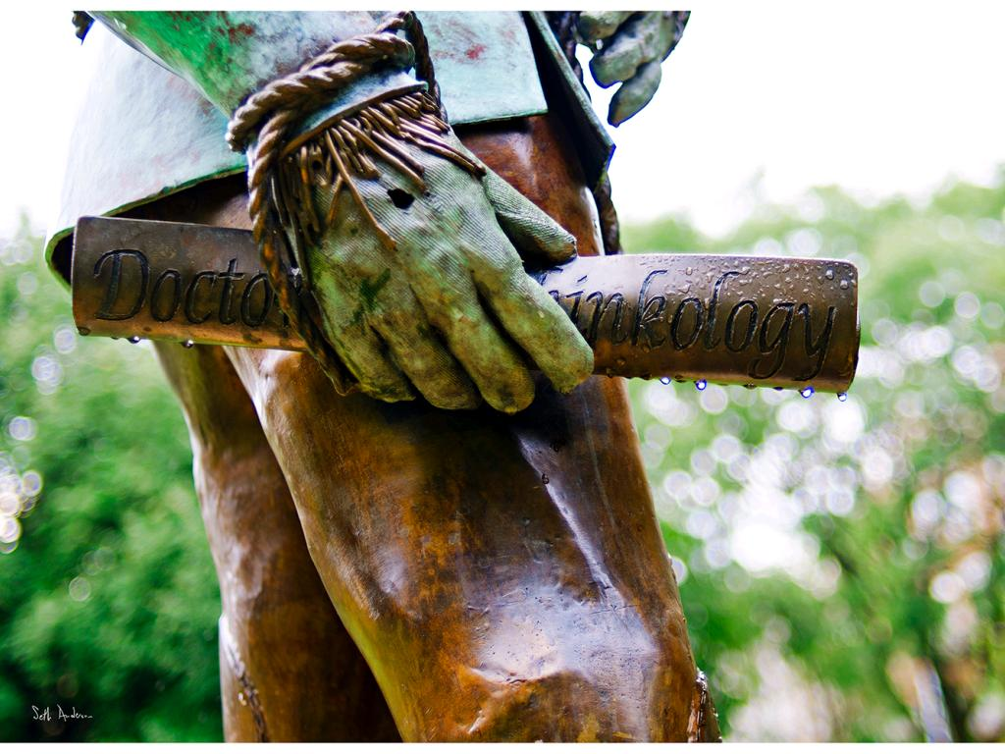
18 Compulsory
12 Elective

Slide 8
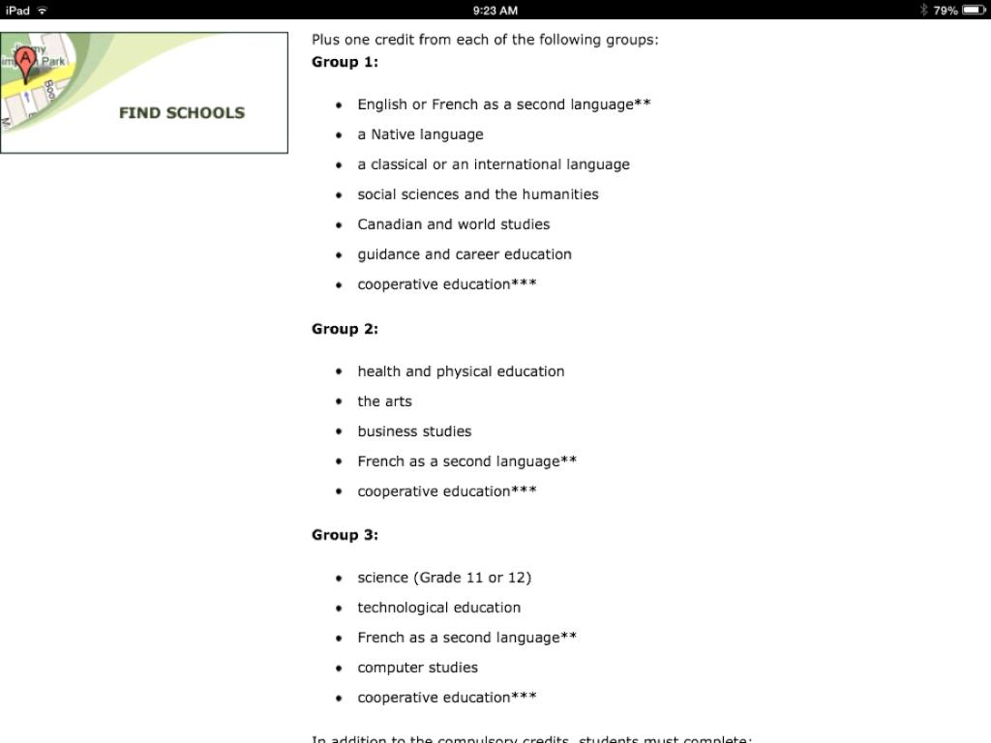
Notes:
- Grade 11 Religion meets the requirements of Group 1

Slide 9
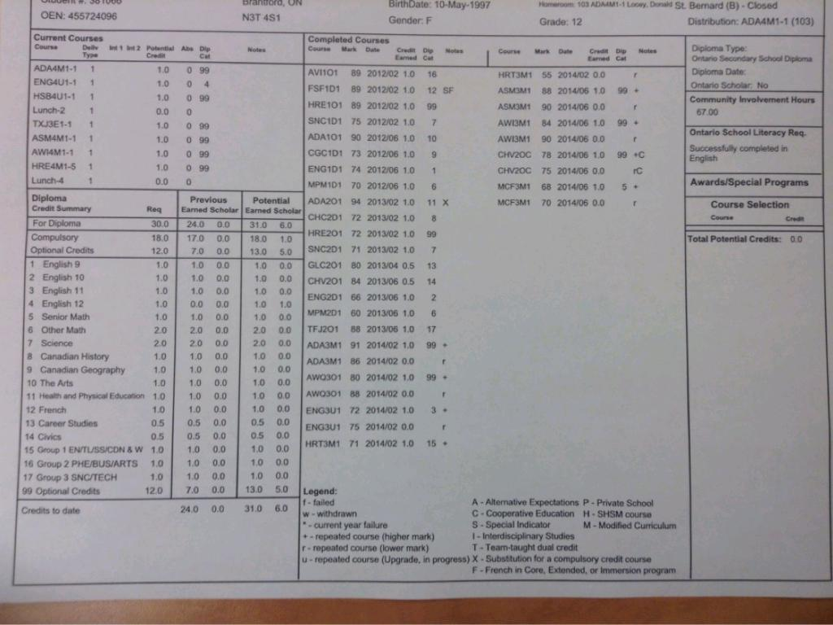
STATUS SHEET
Notes:
- Verify your name and address at the top of the Status sheet

Slide 10
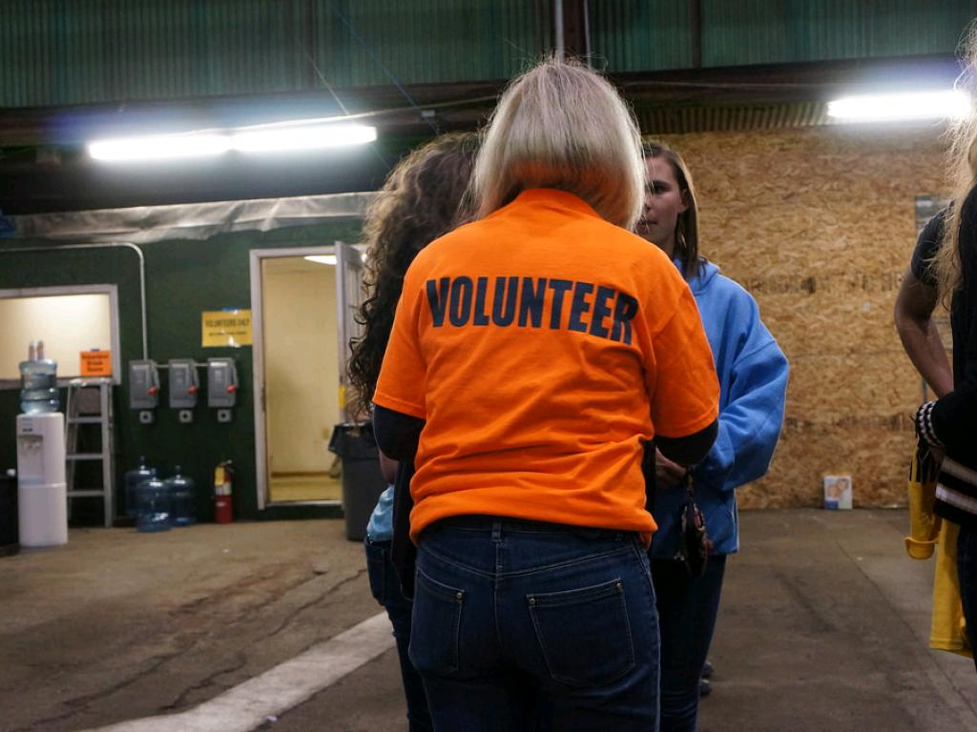
COMMUNITY SERVICE
40 HOURS COMPLETED AND
SUBMITTED BY JANUARY 31, 2023
cc: ccbarr - https://www.flickr.com/photos/30458688@N00
Notes:
-Must be completed un-paid, done at a non-profit organization and you cannot be taking a paid position
-See your guidance counsellor if you are unsure BEFORE completing your hours

Slide 11
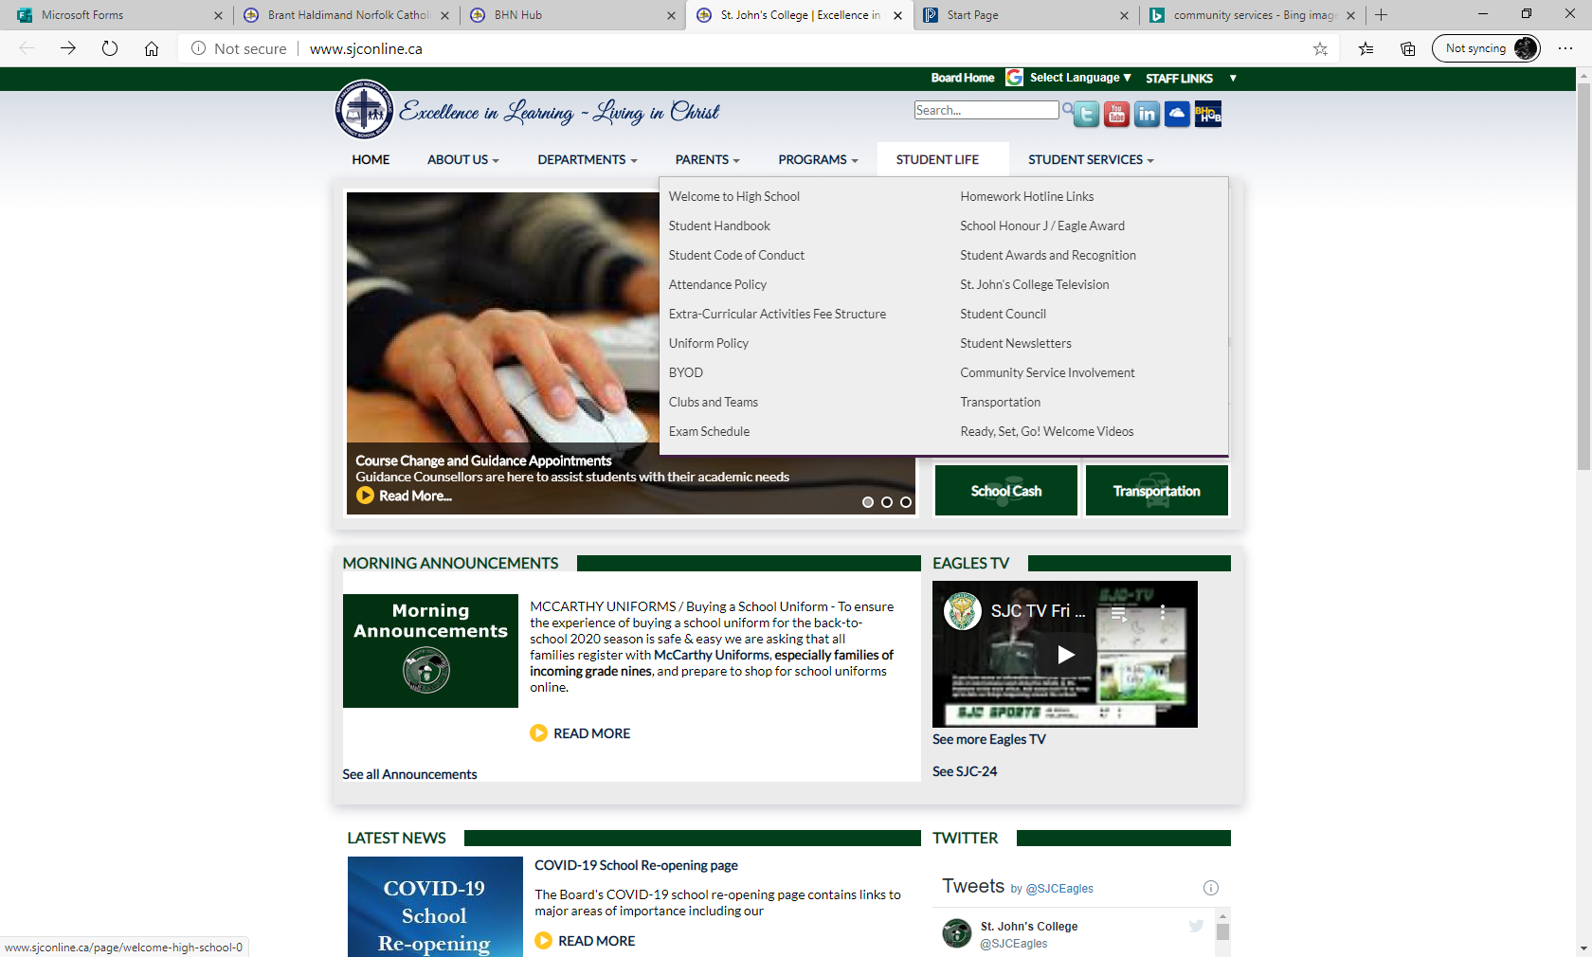
WHERE TO FIND THE FORM
Notes:
-www.sjconline.ca

Slide 12
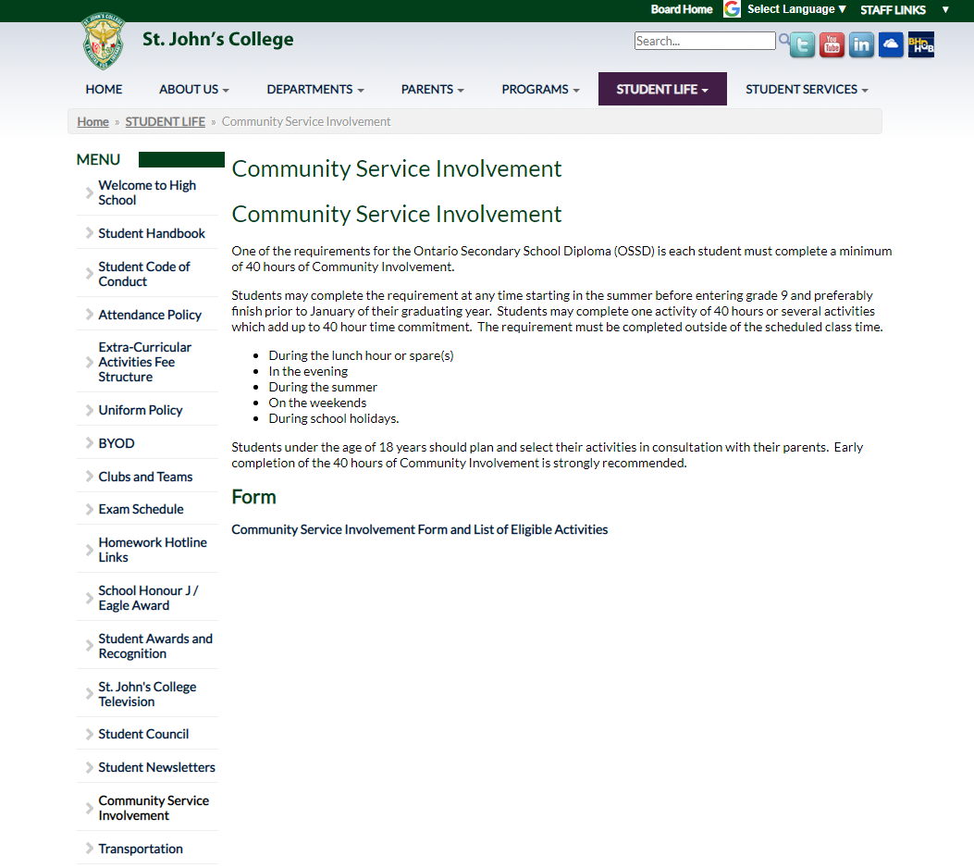
WHERE TO FIND THE FORM

Slide 13
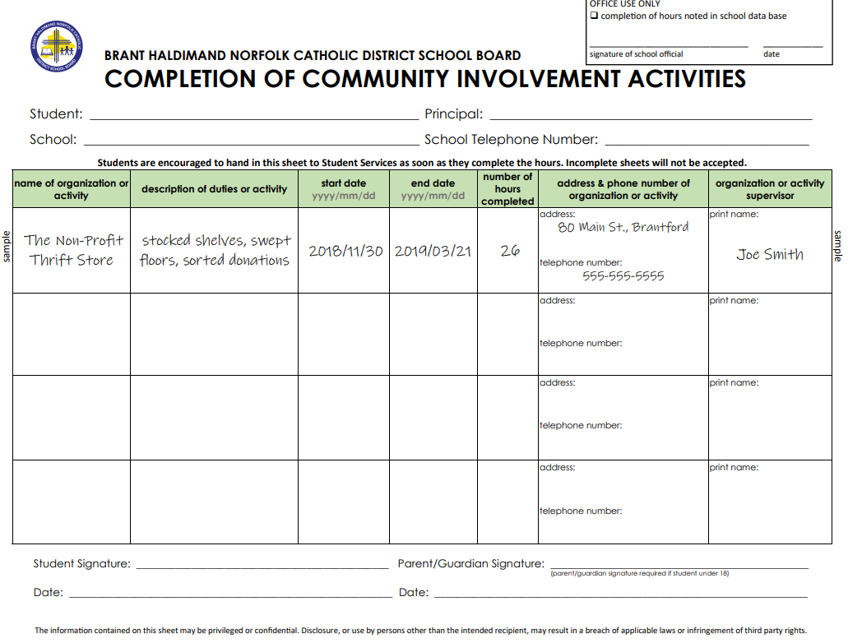
YOU DO NOT HAVE TO HAVE A SUPERVISOR'S SIGNATURE
Notes:
- You DO NOT need a supervisor’s signature

Slide 15
LITERACY TEST
OR TAKE GRADE 12 OLC
cc: ginnerobot - http://www.flickr.com/photos/78011127@N00
Notes:
-Must have passed the Literacy Test or completed the Literacy Course by Graduation
-If you are unsure, please see your Guidance Counsellor

Slide 16
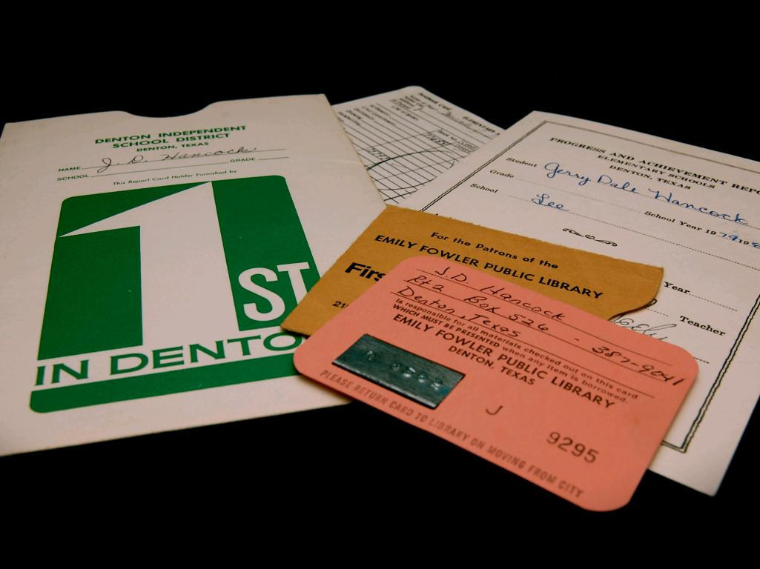
THIS INFO CAN BE FOUND ON EVERY REPORT CARD

Slide 17
Full Disclosure Applies to You!
Five days after mid term report cards are distributed.
DATES:
SEMESTER 1 – NOVEMBER 28, 2022
SEMESTER 2 – MAY 15, 2023
Notes:
-If you drop a class within five days of the midterm report card, it will not appear on your transcript

Slide 18
IT IS THE RESPONSIBILITY OF STUDENTS
to make sure you have pre-requisites for post-secondary
Notes:
-You are responsible to make sure you have what you need for post secondary
-Research pre-requisites and make sure you have them

Slide 19
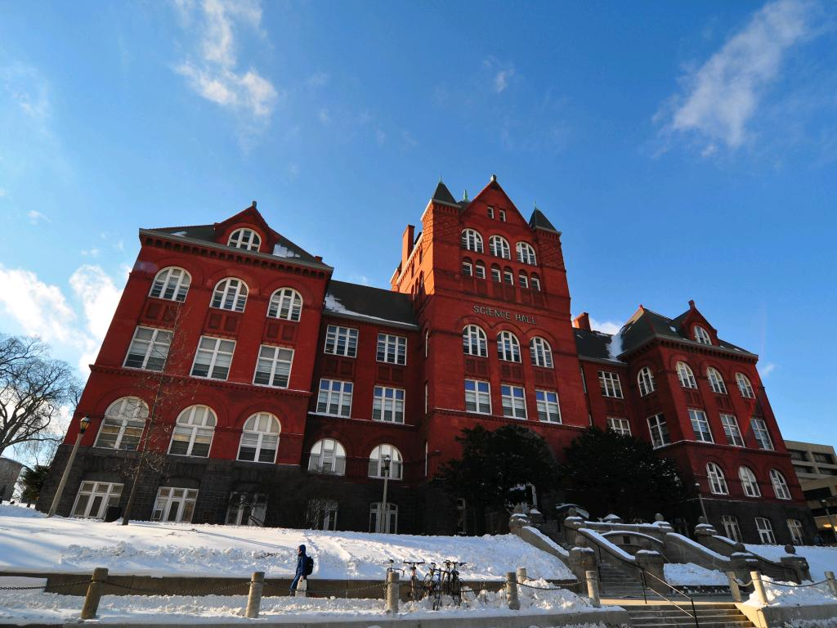
TYPE OF PROGRAM, SIZE OF SCHOOL, TUITION
Notes:
-Schools vary by size, what they offer, how many students get into their program, average to get into their program, pre-requisites and cost
-Do your research

Slide 20
UNIVERSITY Requirements
Six 4U OR 4M Grade 12 Courses
INCLUDING PRE-REQUISITES
Notes:
-You need six 4U/4M coded classes to get into a University ( ie ENG 4U1 )
-Schools take the average of the top six 4U/4M classes including the pre-requisites for their program

Slide 21
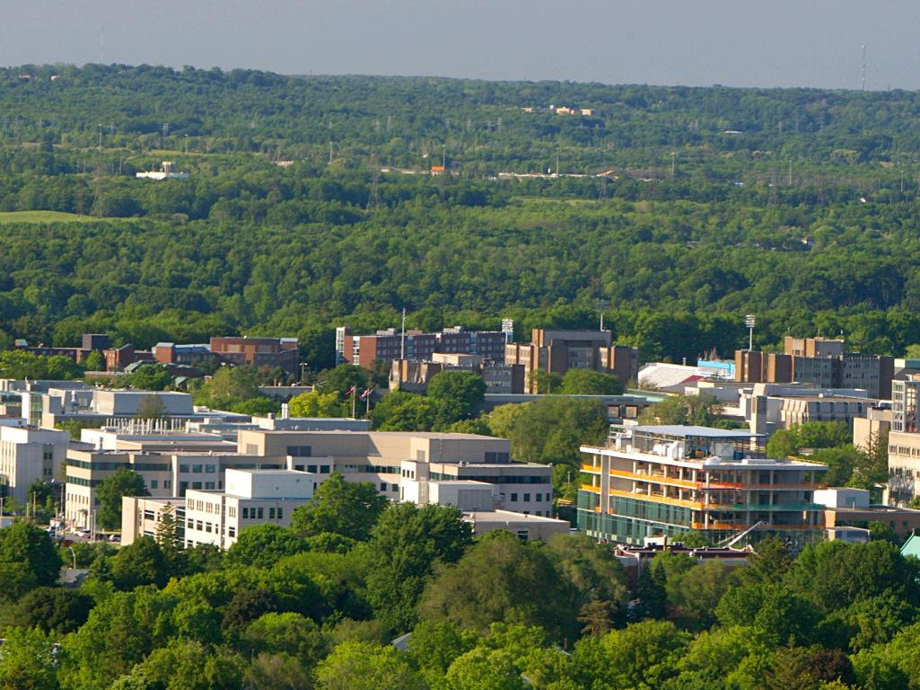
MCMASTER BUSINESS
ENG4U1, MHF4U1,MCV4U1
Notes:
-EXAMPLES – Pre-requisite = ENG 4U1, MHF 4U1, MCV 4U1 plus your next best three 4U/4M courses

Slide 22
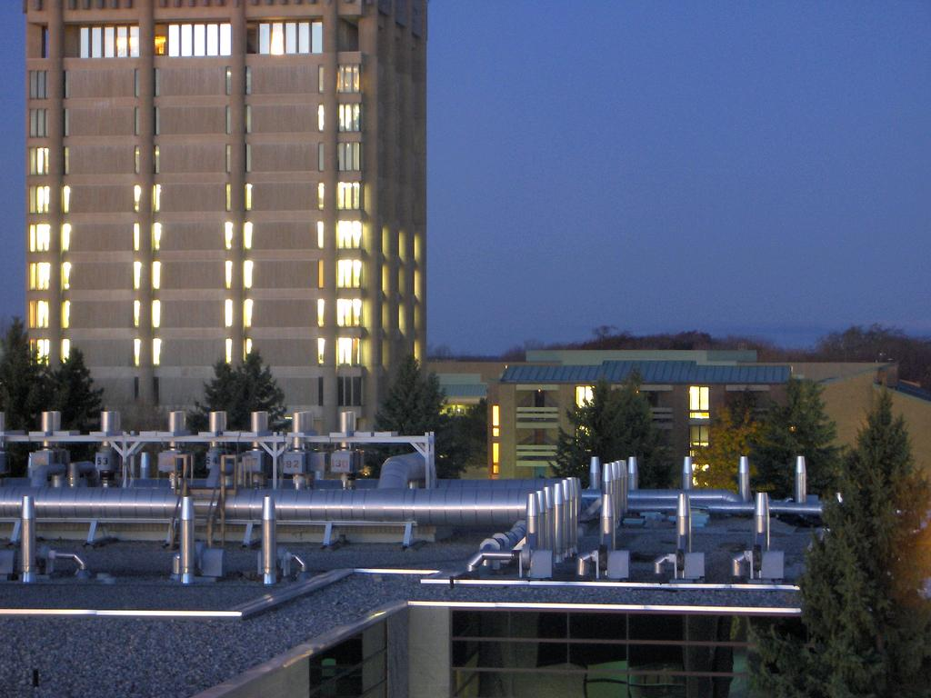
BROCK PHYSICAL EDUCATION
ENG4U, SBI4U, One 4U Math Strongly Recommended Subject: PSK4U
Notes:
-Pre-requisite = ENG 4U1, SBI 4U1, any 4U math, plus you next three highest 4U/4M credits. It is recommended you take PSK 4U1 in high school but not mandatory.

Slide 23
WESTERN MEDICAL SCIENCES
ENG4U MCV4U
SBI4U SCH4U
Strongly Recommended: SPH4U
Notes:
- Pre-requisite – ENG 4U1, MCV 4U1, SBI 4U1, SCH 4U1, and your next highest 4U/4M level classes. It is recommended that you take SPH 4U1.

Slide 24
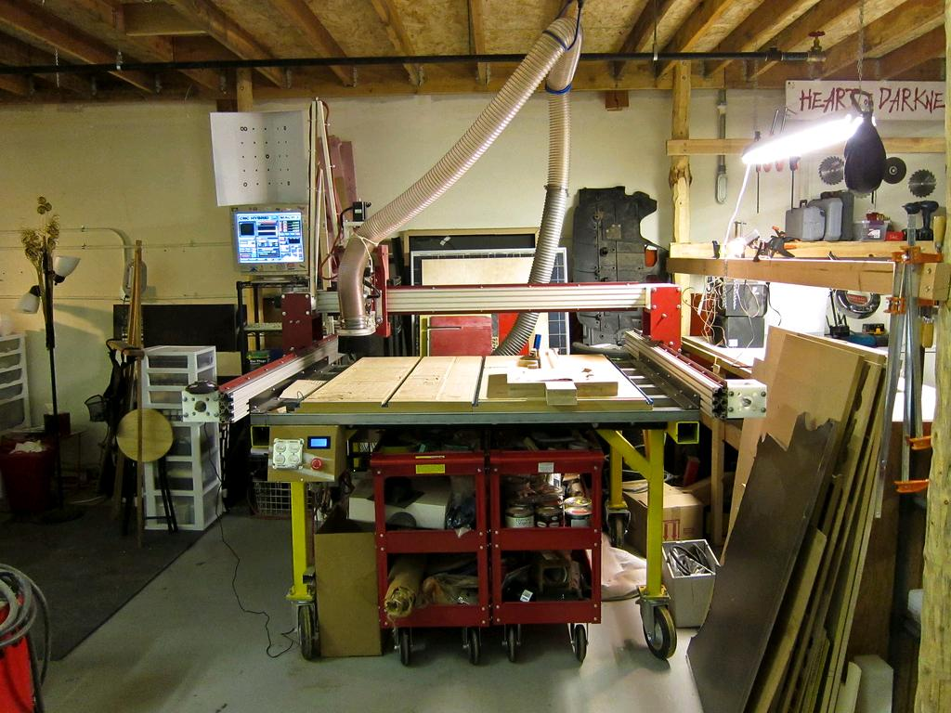
UNIVERSITY APPLICATION WORKSHOP
NOVEMBER 7
PERIOD 2 in the CAFETERIA
Notes:
-We will hold a “How to apply to University workshop “ in November date to be determined
-You should be researching Universities

Slide 25
UNIVERSITY EQUAL CONSIDERATION
January 12, 2023
Notes:
-Apply early to University and before the deadline of January 13 in order to be considered equally with others that have applied
-Christmas Break is a great time to apply

Slide 26
COLLEGE
DIPLOMA AND ONLY PRE-REQUISITES
Notes:
- College pre-requisites involve a Grade 12 English (University or College) and may involve other courses
- It does not involve an average of six classes
- Do your research to find the pre-requisites

Slide 27
MOHAWK COLLEGE CYC
ANY GRADE 12 ENGLISH(U/C)
Notes:
- EXAMPLES – Pre-requisites = Grade 12 English at the University or College level

Slide 28
FANSHAWE BUSINESS
Grade 12 English [U/C] and any Grade 11 or 12 Math[M/U/C]
Notes:
- Pre-requisites = ENG 4U/C, Grade 11 math at College, mixed or University level

Slide 29
COLLEGE APPLICATION WORKSHOP
NOVEMBER 15
PERIOD 1 in the LIBRARY
Notes:
-We will hold a “How to apply to College workshop “ in November, date to be determined
-You should be researching Colleges

Slide 30
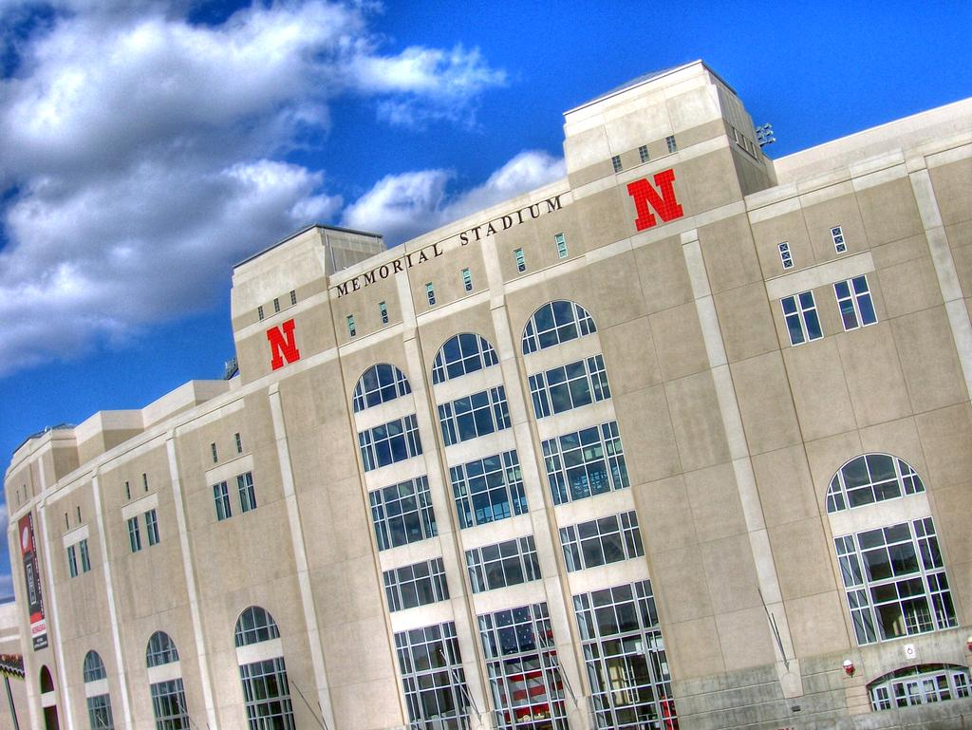
COLLEGE EQUAL CONSIDERATION
FEBRUARY 1
Notes:
-Apply early to College and before the deadline of February 1 in order to be considered equally with others that have applied

Slide 31
COLLEGE ACCEPTANCE
equal consideration date until waitlists are established

Slide 32
SCHOLARSHIP/BURSARIES
Notes:
-Scholarships are given based on marks and academic achievement
-Bursaries are given due to financial need

Slide 33
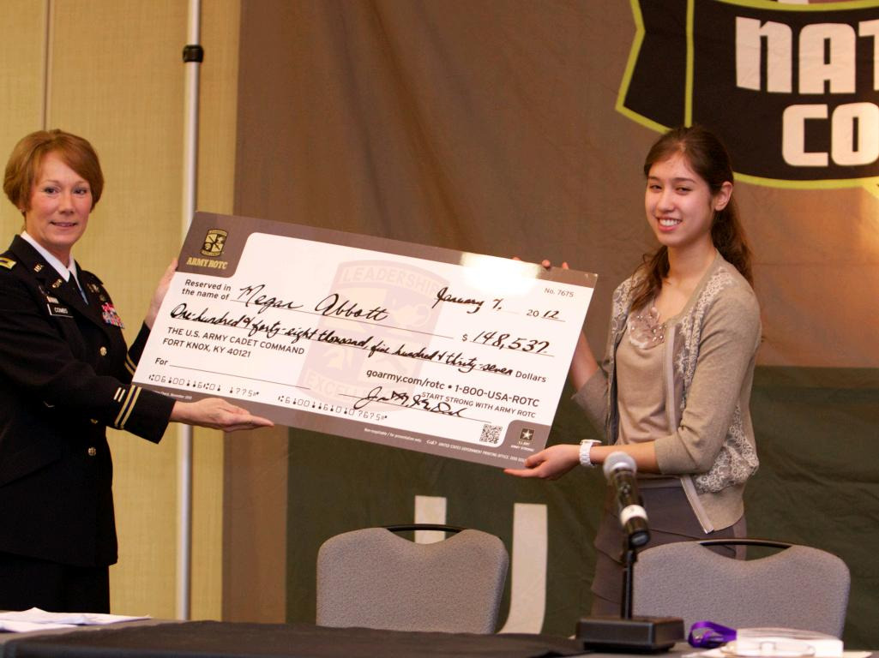
IT IS THE STUDENT'S RESPONSIBILITY
to apply for all scholarships and bursaries

Slide 34
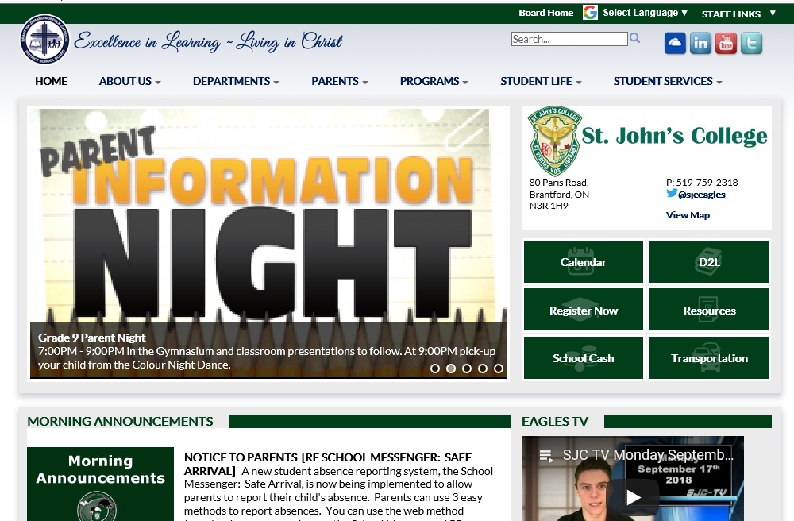
THEY ARE ON THE WEBSITE
Notes:
-www.sjconline.ca

Slide 35
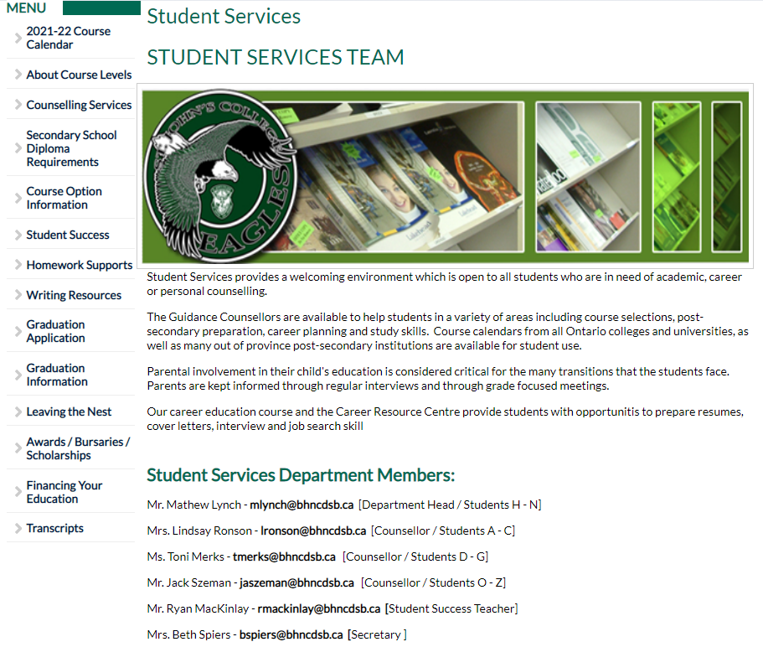
DOWN THE LEFT SIDE
Notes:
-The next page will have a list of applications on it
-Download, complete and submit to Student Services

Slide 36
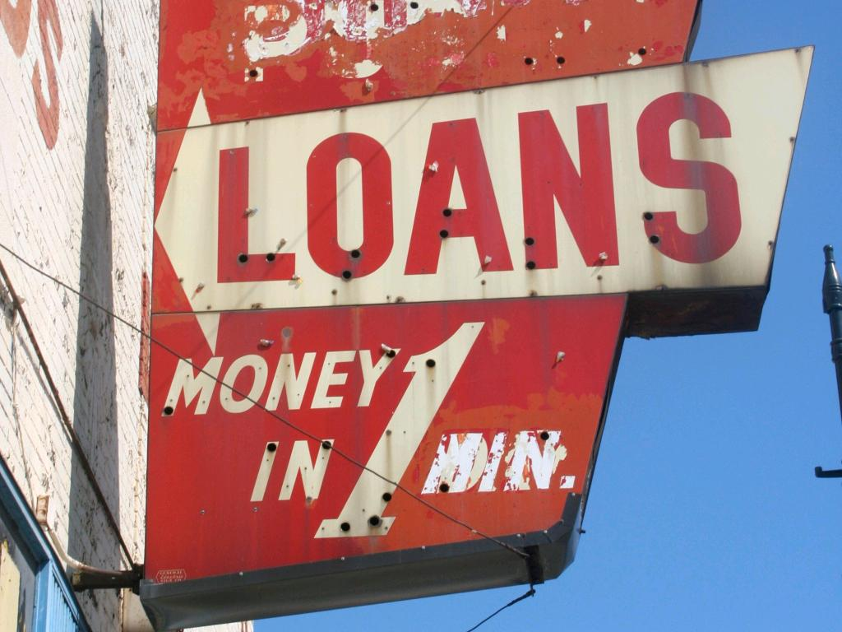
OSAP
https://www.ontario.ca/page/how-apply-osap#section-0
cc: zingbot - https://www.flickr.com/photos/97888103@N00
Notes:
-Ontario Student Assistance Program – Government Loan
-You can do a calculation in the spring
-You will need an acceptance in order to get the funds

Slide 37
APPRENTICESHIPS
Notes:
-One destination after High School may be an Apprenticeship where you connect with an employer and work and go to school to get your Trade qualifications
-Connect with the Co-op Department for more details

Slide 38
DIRECTLY TO WORK
Notes:
-One destination after High School may be to go directly to work
-Connect with the Co-Op Department for more details

Slide 39
NEXT STEPS

Slide 40
TALK TO PARENTS, TEACHERS, FRIENDS
cc: Senthil Prabu.S - https://www.flickr.com/photos/73839719@N00
Notes:
-People around you can help give you ideas about potential post secondary destinations
-Make the best decision for YOU

Slide 41
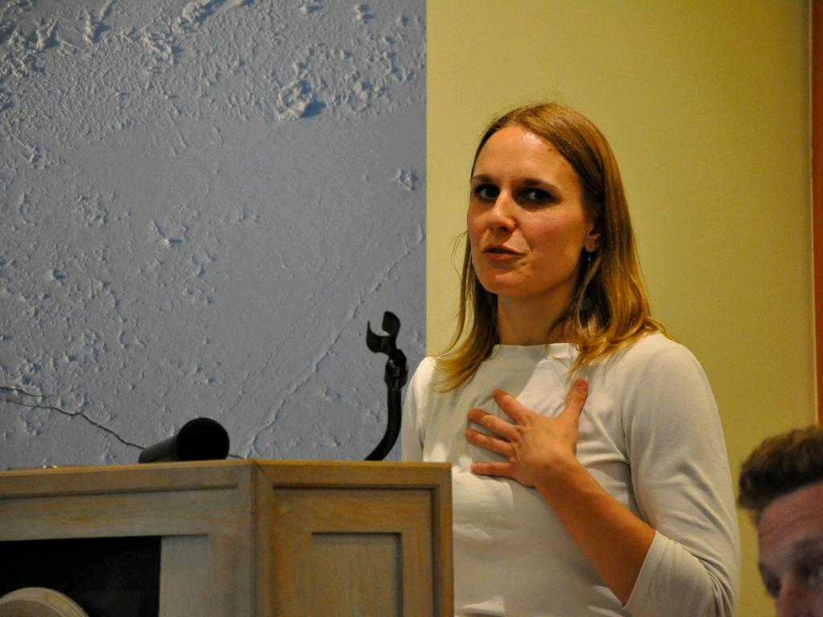
UNIVERSITY and COLLEGE
PRESENTATIONS
SIGN UP IN STUDENT SERVICES
Notes:
-This year there will be few in person presentations
-Visit post secondary school websites
-We post virtual presentations and viewbooks on www.sjconline.ca – Student Services

Slide 42
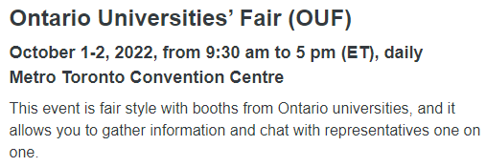
PRESENTATIONS
cc: mariskar - http://www.flickr.com/photos/74662864@N00

Slide 43
ONTARIOUNIVERSITIESINFO.CA
ONTARIOCOLLEGES.CA
APPRENTICESEARCH.COM
CHECK OUT THESE WEBSITES
Notes:
- Do your research

Slide 44
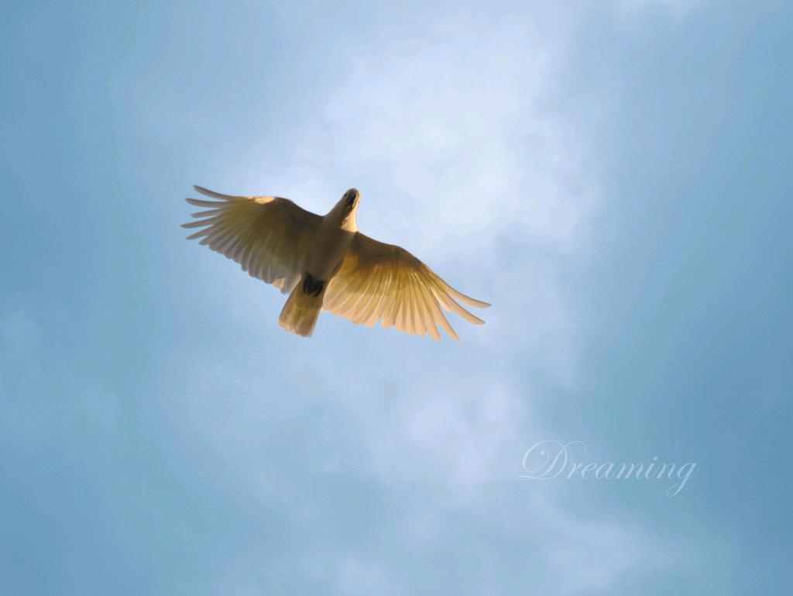
DREAM BIG
Notes:
-Never say that you can’t

Slide 45
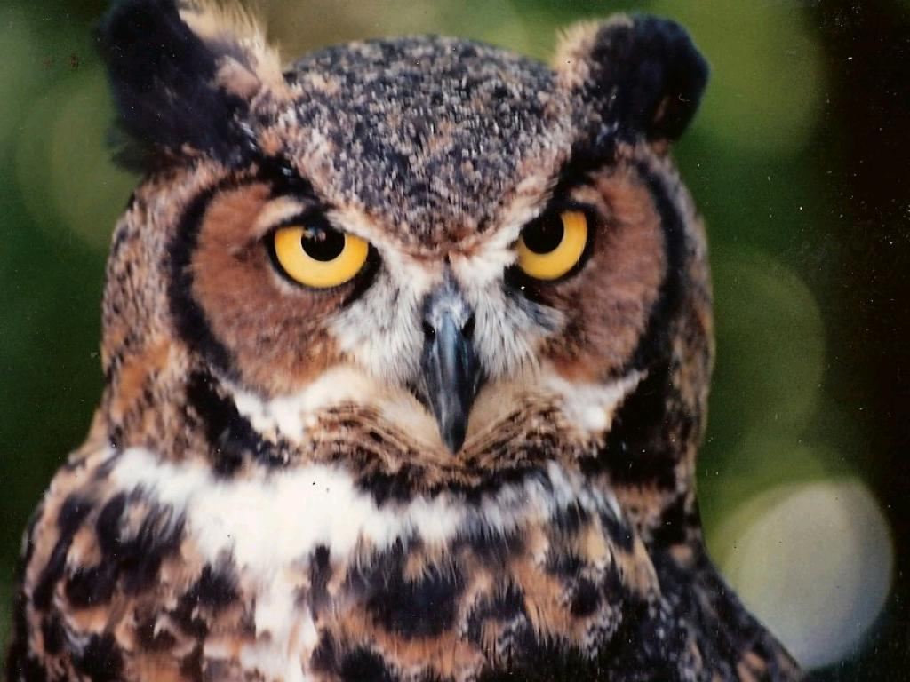
PLAN WISELY
cc: roberthuffstutter - https://www.flickr.com/photos/29528454@N04
Notes:
-Make a plan and adjust as needed

Slide 46
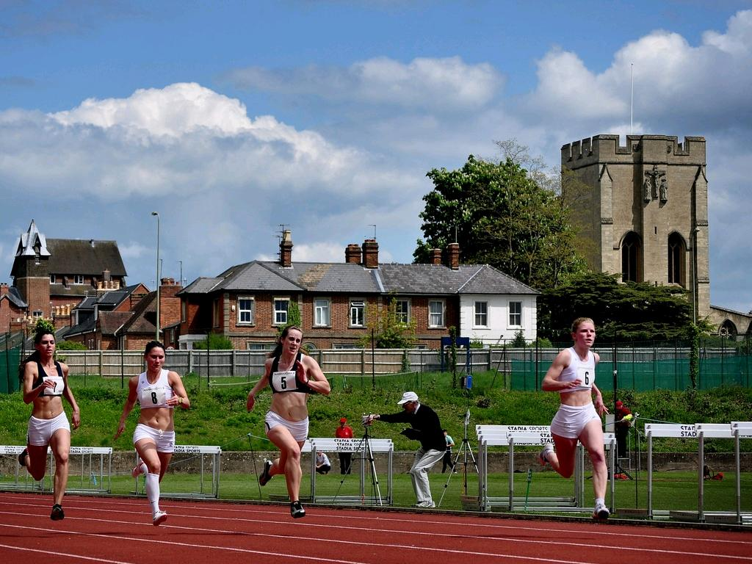
LIFE IS NOT A SPRINT
Notes:
-Take your time
-You do not have to complete all of your goals in one year

Slide 47
YOU CAN COME BACK
Notes:
-Is a Post-Grad year at SJC for you?

Slide 48
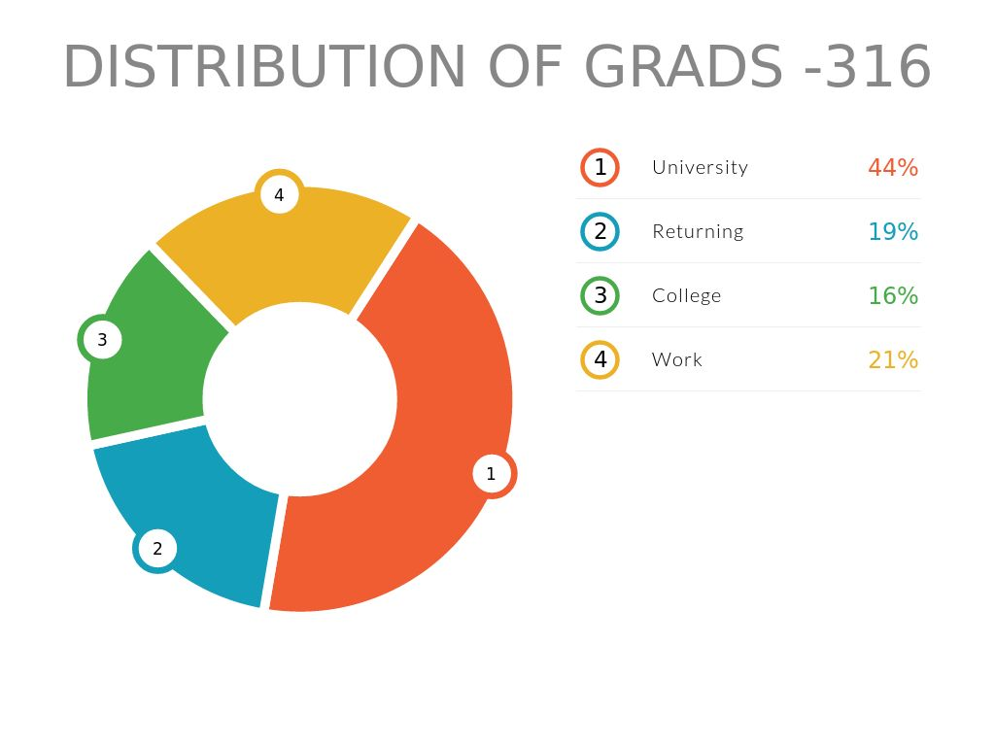

Slide 49
GET GOOD MARKS!
DO NOT ASK TEACHERS FOR MARKS

Slide 50
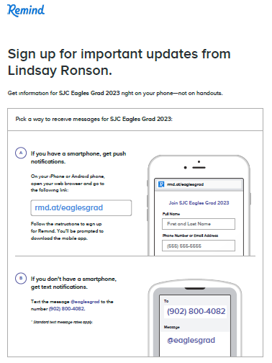
GRAD
REMIND
SIGN UP
Notes:
- Sign up for the Graduation remind app, and view Twitter

Slide 51
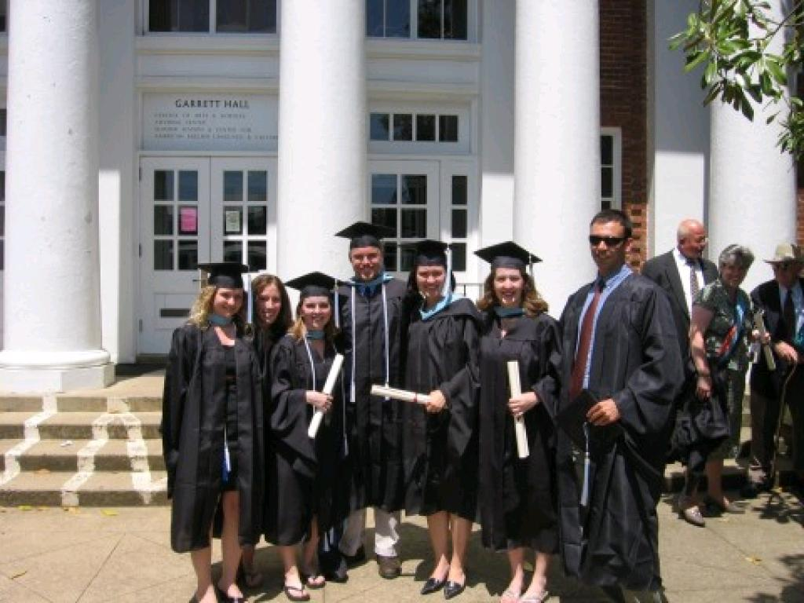
GRAD APPLICATIONS
cc: ssstok - https://www.flickr.com/photos/54639028@N00

Slide 52
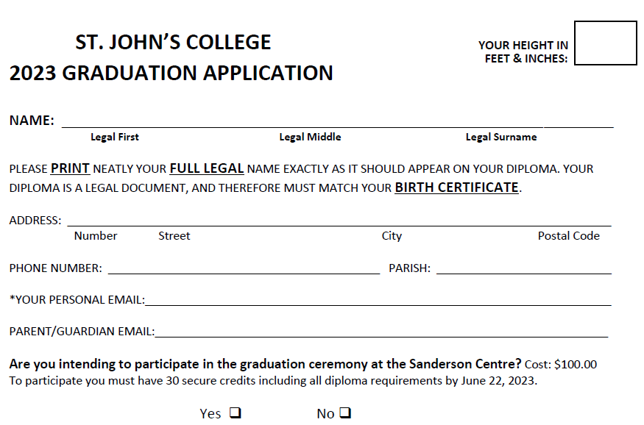
GRAD APPLICATION

Slide 53
HEIGHT (FOR YOUR GOWN)
Notes:
- Please provide an accurate height so your grad gown is the appropriate length

Slide 54
LEGAL NAME
Notes:
-Use your legal name on your birth certificate

Slide 55
ADDRESS

Slide 56
WOULD YOU LIKE TO BE IN THE CEREMONY?
WOULD YOU LIKE PHOTOS?

Slide 57
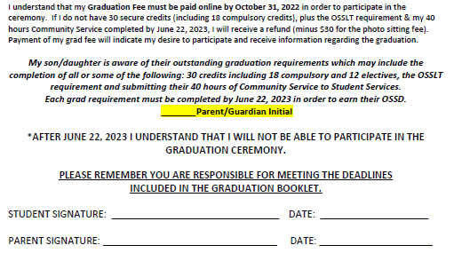
GRAD REQUIREMENTS
ACKNOWLEDGEMENT
Notes:
-Credit information is found on your status sheet

Slide 58
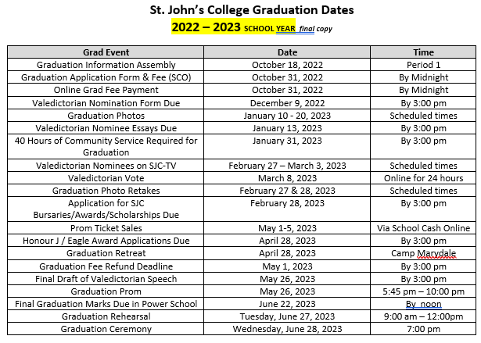
IMPORTANT DATES

Slide 59
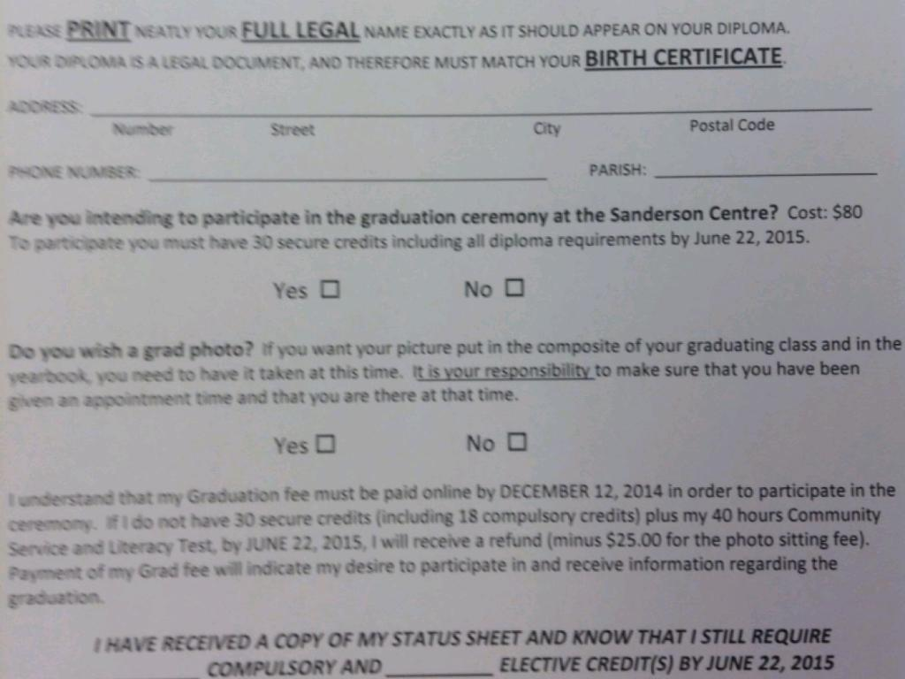
COMPLETE
GRAD APPLICATION
ONLINE BY OCTOBER 31, 2022
SEE COUNSELLOR AFTER IF YOU HAVE
QUESTIONS OR CONCERNS

Slide 60
DATES FOR
GRAD PHOTOS
JANUARY 10-20
GRAD FEES MUST BE PAID BEFORE
OCTOBER 31 IN ORDER TO RECEIVE
ONLINE BOOKING INFO FOR GRAD PHOTOS

Slide 61
DATES FOR
GRAD PHOTOS
JANUARY 10-20
GRAD PHOTOS BOOKED DIRECTLY
THROUGH EDGE IMAGING BOOKING
SYSTEM

Slide 62
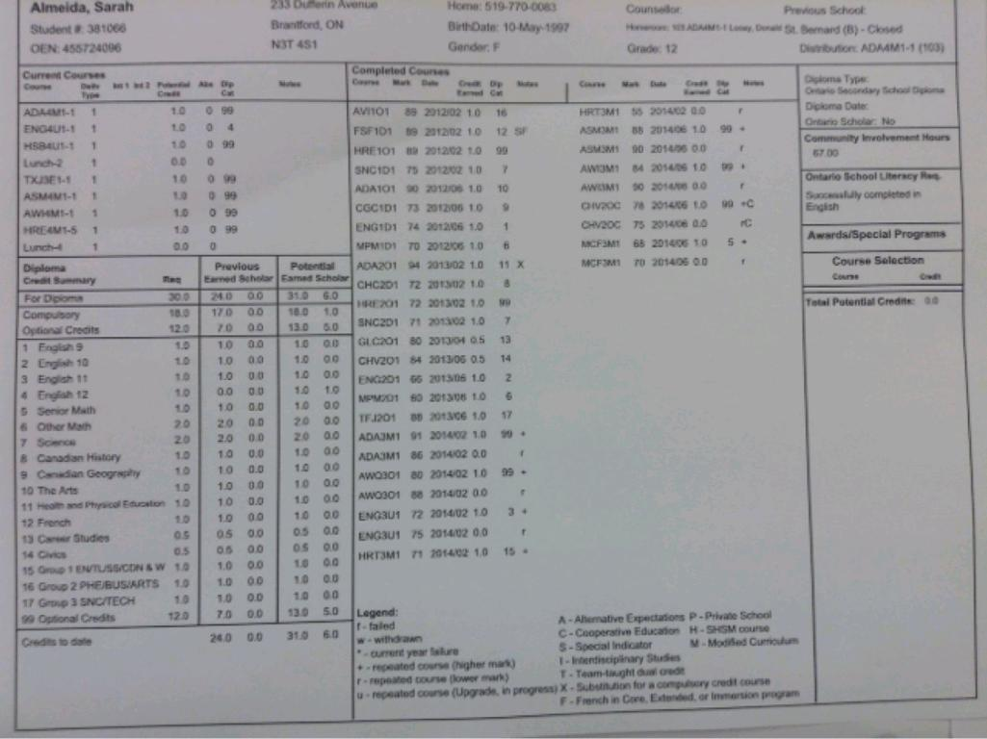
STATUS SHEET

Slide 63
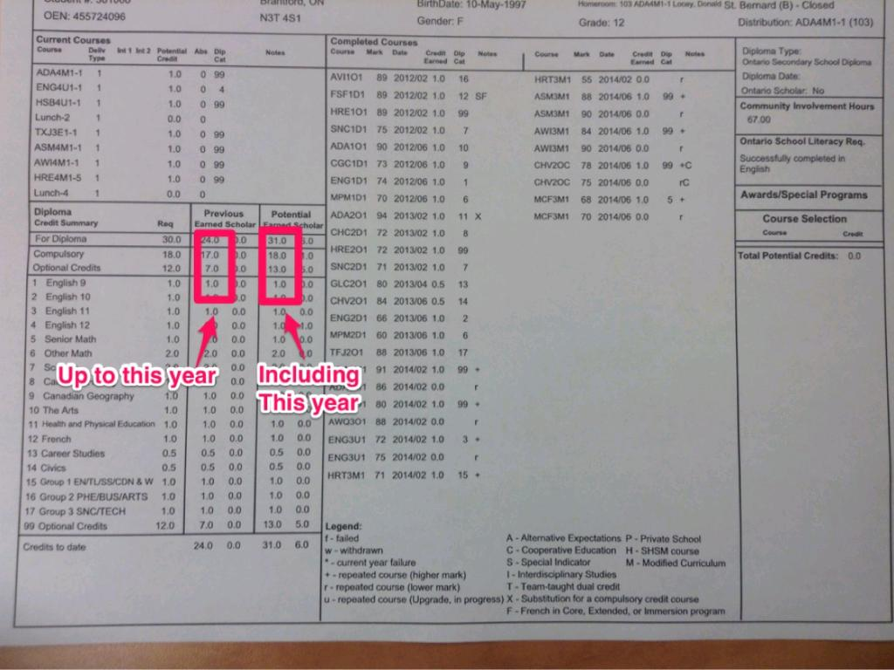
CREDITS
MUST HAVE 18 COMPULSORY & 12 ELECTIVES

Slide 64
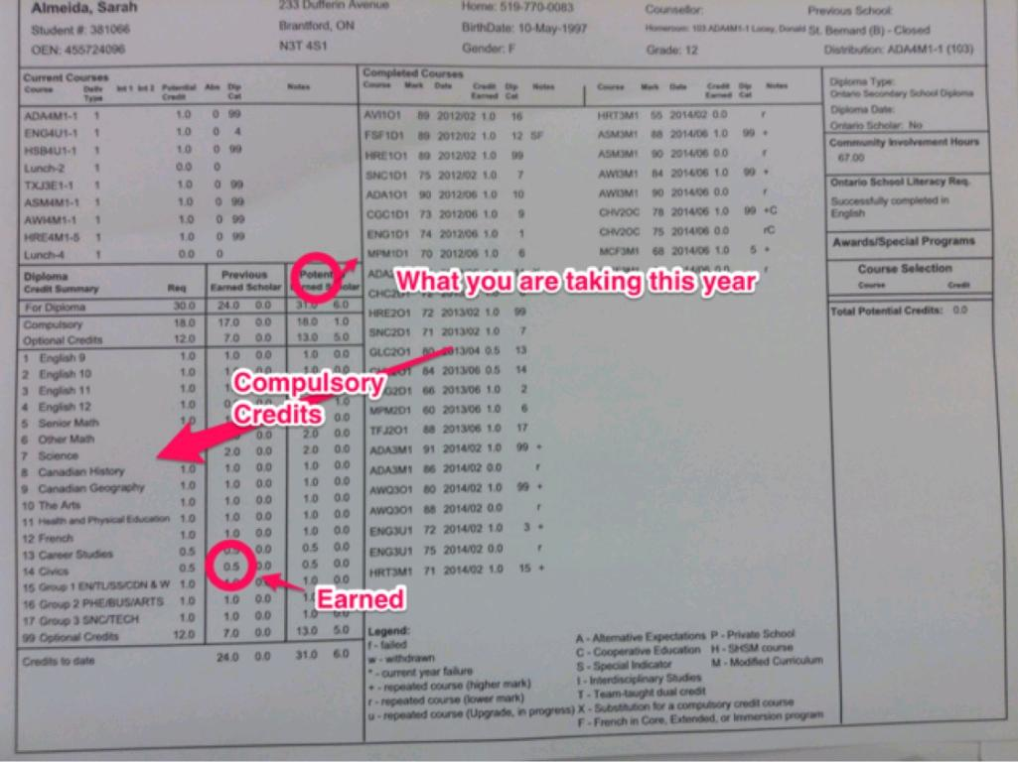
UNDERSTANDING HOW MANY CREDITS YOU HAVE EARNED
COMPULSORY &OPTIONAL

Slide 65
18 COMPULSORY CREDITS
earned
potential
12 ELECTIVE

Slide 66
POTENTIAL CREDITS
MUST BE 30 OR OVER
MUST BE 30 OR OVER

Slide 67
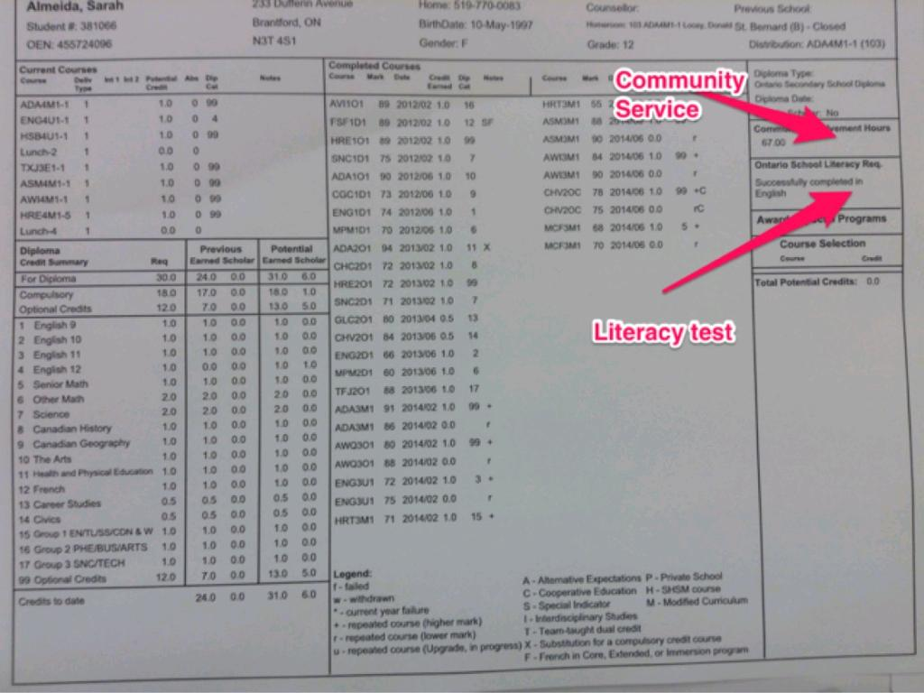
GRAD REQUIREMENTS
Notes:
-Need to have 40 or more hours in Community Involvement Hours box
-Should say successfully complete in English in Ontario School Literacy Req box

Slide 68
REMINDERS: CHECK YOUR BOARD EMAIL EMAIL ETIQUETTE PHONE ETIQUETTE FILL OUT FORMS IN DETAIL
Notes:
-Look at your board e mail regularly. This is how we communicate with you.
-E mail is not texting. Use proper sentences, be polite, make a good first impression
-Leave clear, detailed messages on the phone with your name and phone number stated clearly
-Make sure forms are filled out in detail so the reader knows exactly what you want

