Slide 1
Applying Online to
Ontario’s Universities
101 Online Application for
Ontario High School Students
www.ouac.on.ca/ouac-101

Slide 2
Step 1:
Get Your OUAC Access Codes
Your guidance counsellor will give you a confidential letter containing your access codes:
Temporary PIN
School Number
Student Number
These numbers allow you
to access your 101 Online Application.
Your PIN is confidential!
Don’t share it with anyone else.
Notes:
The Personal Identification Number (PIN), in conjunction with the school number (MIDENT) and the student number (SSSN), allows each student to log in and access their personal 101 account. PINs should not be shared with anyone!
The OUAC will generate a PIN for each student once it receives their electronic school records. These personal access codes will then be made available to the school for distribution to the students by the guidance office. In case any students lose their access codes, a checklist of names and PINs will be made available within Counsellors’ Online Services.

Slide 3
Step 2:
Research Your University Options
      Visit eINFO (www.electronicinfo.ca) to see what each university has to offer. Review the eINFO Postcard.
      Read the 101 Application Guide (available at www.ouac.on.ca/guide/101-app-guide) for information about the universities and up-to-date program information.
      Check out university publications, websites and tours.
      Talk to counsellors, family, teachers and friends.
      Write down your program choices and codes, and keep them handy.
Notes:
Students are encouraged to research their university options prior to logging in to the 101 Online Application. It is recommended that students make a list of their program codes and keep it handy when they log in. This greatly reduces the time required to complete the application.

Slide 4
Step 3: Mark Your Calendar
      October/November 2017: Schools distribute Access Code letters for the 101 Online Application.
      January 17, 2018: Deadline to submit your completed application to the OUAC.
      February 6, 2018: Recommended last date to make changes to your application.
      May 29, 2018: Latest date you can expect a response to your application for admission.
      June 1, 2018: The earliest date you may be required to respond to an Ontario university offer of admission and give a financial commitment (e.g., registration deposit, residence deposit, etc.).
Notes:
These dates are established by guidance counsellors, the Ontario universities and the OUAC. Individual high schools may have additional internal deadline dates.
Students should not wait until the last minute to submit their online applications – internet connections may be interrupted as the deadline date approaches. January 17, 2018 is the application deadline. Applications will be accepted after this date, but certain limited enrollment programs may no longer be available.
February 6, 2018 is the last recommended date to make changes to an application in order to be eligible for early admission consideration.

Slide 5

Step 4: Apply!
Access the online application at: www.ouac.on.ca
Notes:
Students will access the 101 application at: https://www.ouac.on.ca/.

Slide 6
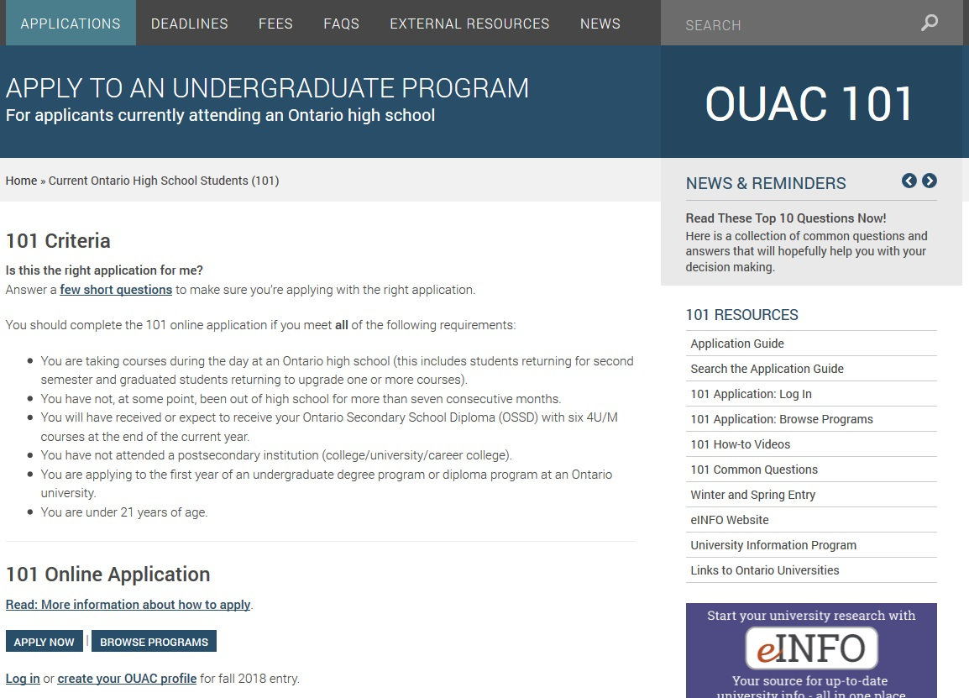
Let’s Get Started!
Access the online application directly at: www.ouac.on.ca/ouac-101
Notes:
Ontario high school students have their own page on the OUAC website that includes all the links related to the online application process: www.ouac.on.ca/ouac-101/.

Slide 7
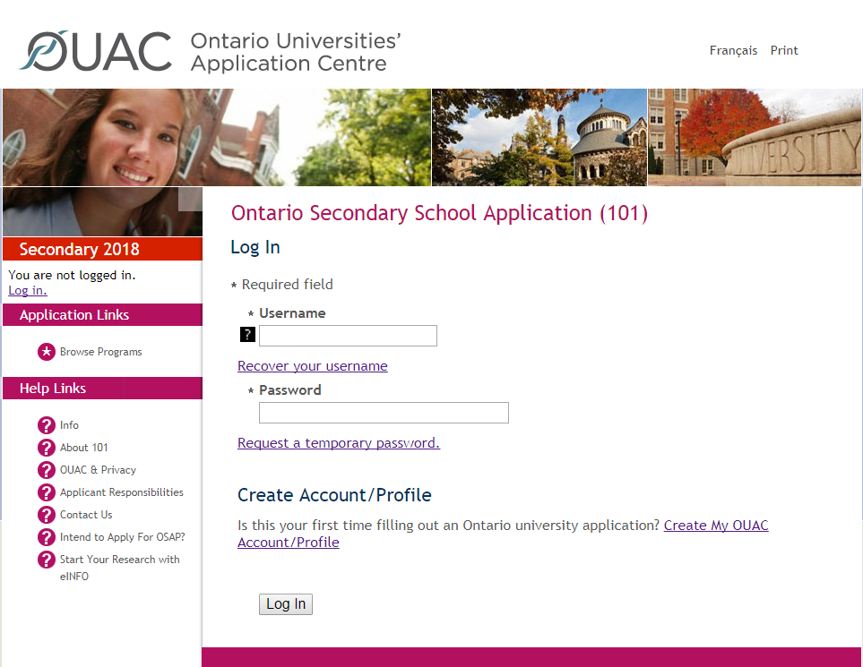
Creating a Profile For the First Time
The first time you log in:
You will need to create an OUAC Account/Profile.
Notes:
While students can browse programs through the “Browse Programs” link without logging in to the application, they must log in to the application to access personalized applicant data and prepare their application. When logging in for the first time, students must create an OUAC Profile.

Slide 8
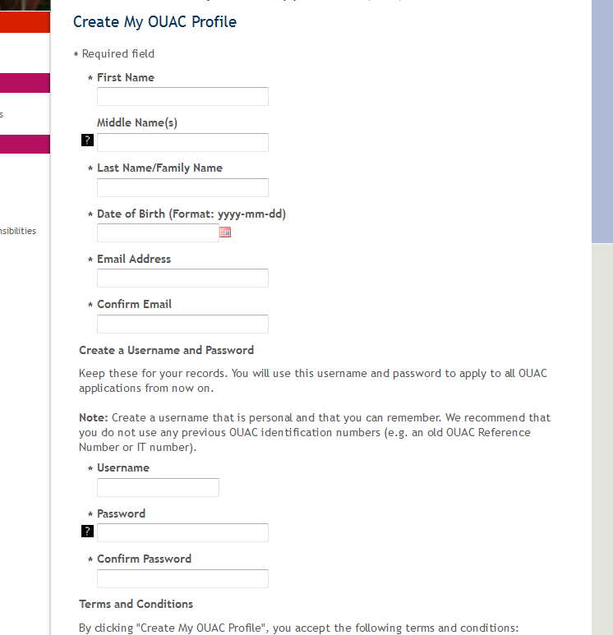
Your OUAC Profile
Create Your Username and Password
Create a username that is easy for you to remember. You will use it to apply to all OUAC applications from now on.
Notes:
Students fill in their personal information and create a username and password. They should create a username that is personal and easy for them to remember as they will be using this username and password to log in to their application from now on, and to apply to all future OUAC applications.

Slide 9

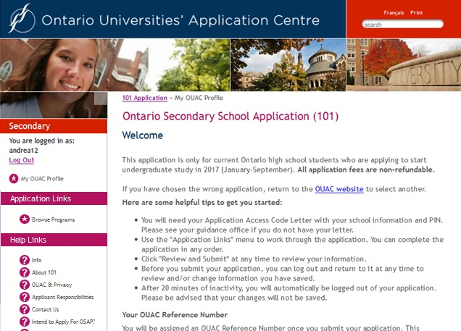
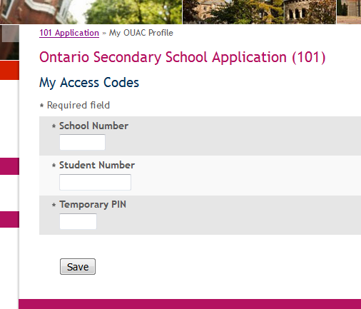
Welcome and Access Codes
Review the helpful tips on the Welcome page and enter your access codes provided by your guidance counsellor to start your online application.
Notes:
When logging in to their application for the first time, student must use their Confidential Access Codes.
It is important to enter the access codes exactly as they are shown in the letter and to keep them confidential.
The application account is the student's own personal storage space on the OUAC site. Students may return to the account at any time to review and/or change saved information prior to submitting their application.

Slide 10
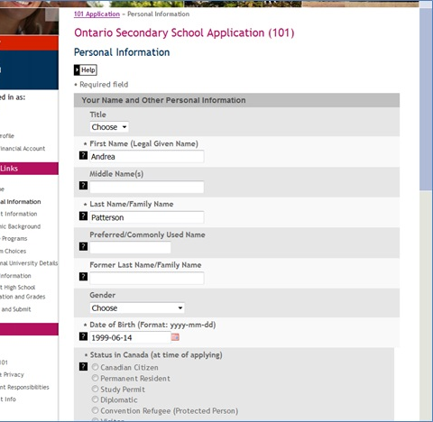
Navigating the 101 Online Application
“Help” links are located on most of the application screens or on the fields themselves.
Notes:
The main navigation bar appears on the left side of each screen throughout the online application to guide students through the process.

Slide 11
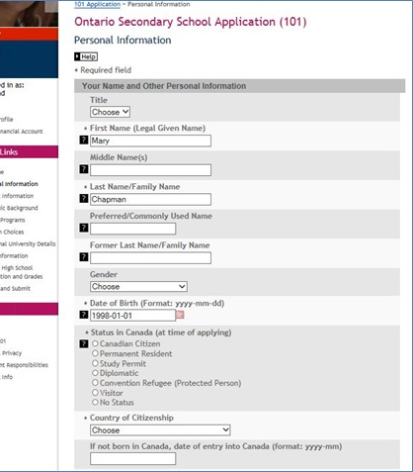
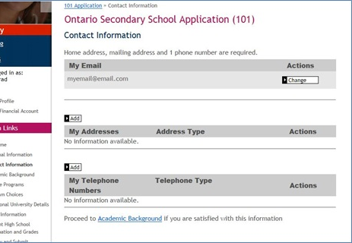
Add Personal and Contact Info
Notes:
Ensure that all information in the “Personal Information “ and “Contact Information” sections is accurate and complete. Additions and corrections must be made as necessary. For example, it is important that all legal given names be provided. Nicknames, abbreviations and initials should not be used. Students must enter email addresses accurately, as the OUAC and the universities correspond with students via email during the application process.

Slide 12
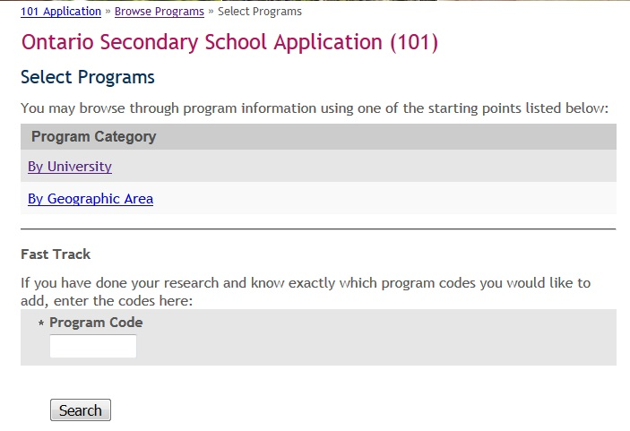
Select Your Programs
These are the search options.
Enter an OUAC program code to use the Fast Track option.
Notes:
Students can enter all of their desired program codes on one screen using the “FastTrack” option.
Or students can explore using the Search Options.

Slide 13

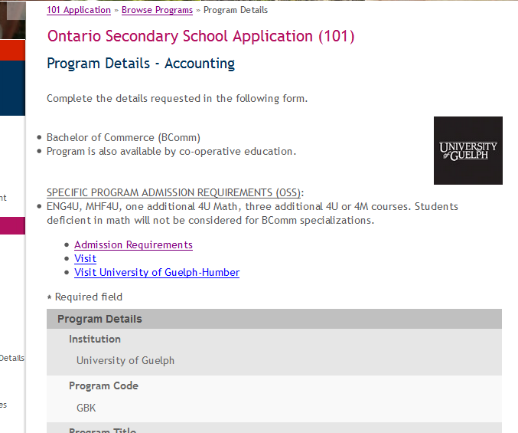
Once You’ve Selected a Program
Complete the program details for each program selected.
View the Admission Requirements for the program
Notes:
Near the top of this screen, students can view and confirm the admission requirements for the selected program.
Then, for each program code chosen, they must complete the details screen. This includes indicating the "Subject of Major Interest" (if applicable), co-op options (if available), as well as details about anticipated start term. The program choices and their details are then added to the online application.
Students may apply to as many Ontario universities/programs as they wish; however, they are limited to a maximum of three program choices at any one university (including the university’s affiliates). Some universities may further limit the number of programs to which candidates may apply.

Slide 14
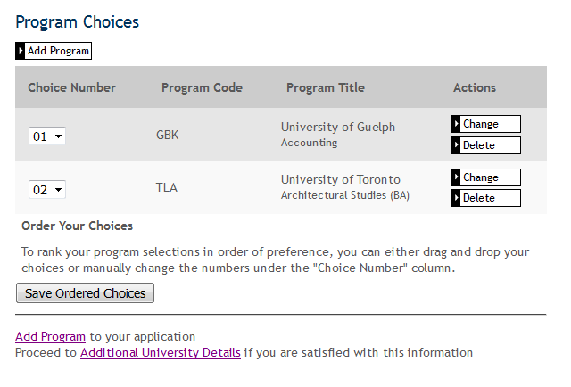
Order Your Choices
The choice order does not affect scholarship or admission consideration unless a university’s literature specifically states that it does.
Notes:
Number program choices in order of preference. Numbering does not affect scholarship or admission consideration unless a university specifically states this in its literature. By default, program choices initially appear in the order that the student selected them.

Slide 15
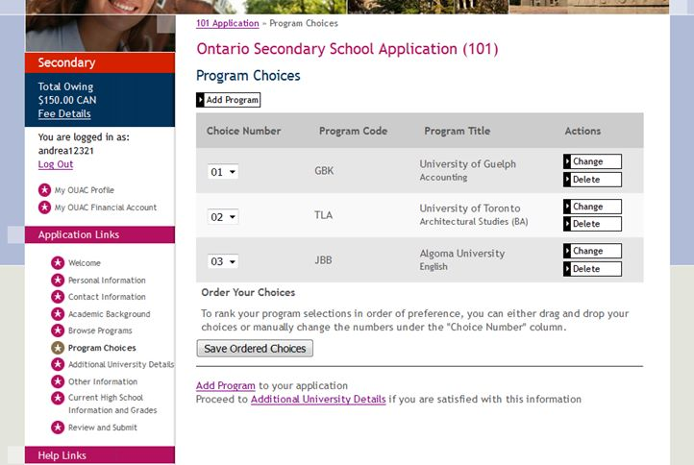
Fees
The cost is $150 for the first 3 university/program choices and $50 for each additional choice.
Notes:
The cost is $150 for the first 3 university/program choices and $50 for each additional choice.
Students can see their fees in “real time” by clicking “Fee Details”.

Slide 16
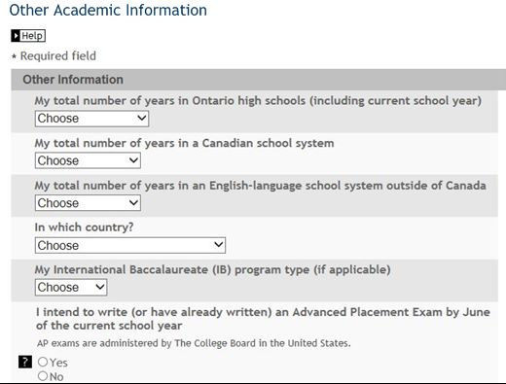
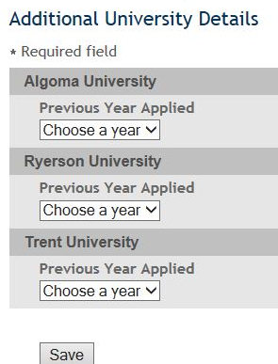
Answer Questions
You must complete the Additional University Details and questions in the “Other Academic Information” section.
Notes:
If a student previously applied to any programs at 1 of their university choices, they must indicate this in Additional University Details.

Slide 17
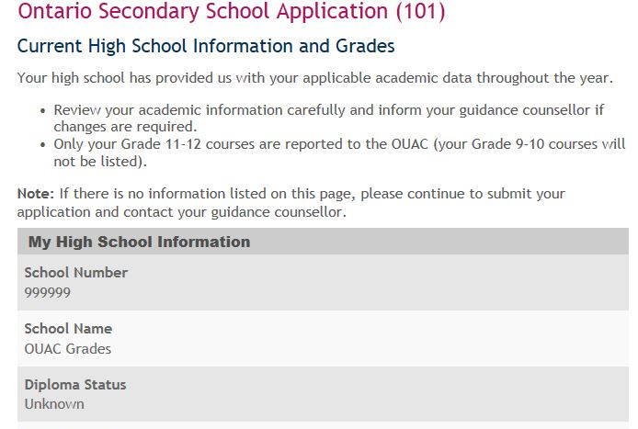
Current High School Info/Grades
Please monitor and report errors to your guidance counsellor.
This screen is “read-only”.
Notes:
It is the student’s responsibility to check the “Current High School Information and Grades” screen carefully and to report any errors to the guidance office.
This screen is “read-only”, which means that students cannot alter this data. The information should, however, be checked carefully for any errors or omissions. If there are errors, the student should continue to prepare and submit the application, and then notify the guidance office as soon as possible.
If no academic data is recorded, the student must first complete and submit the application. School officials who have access to “Academic Updates” on Counsellors’ Online Services may log in and update the student’s academic data.
Counsellors may encounter this situation for students for whom they manually created a PIN using Counsellors’ Online Services.
If a student is taking a course at a school outside their “home” school, they are responsible for ensuring that this school submits the course information and all updates to their “home” school and to the OUAC. If the course information is missing from their application, they must contact that school and request that they submit the missing information to the “home” school and to the OUAC.

Slide 18
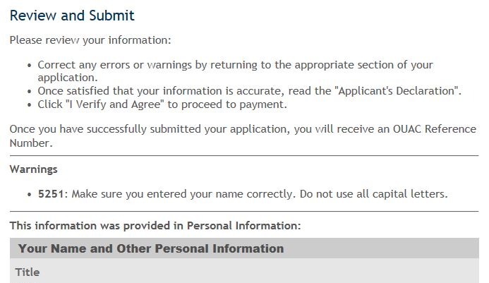

Submitting Your Application
Click here to proceed to the payment screen.
Notes:
Once all information has been added to the application, the student should click “Review and Submit”. All the information entered earlier in the application process will be presented on one page for verification. Students should print this page for their records.
To proceed to the “Payment” screen, the student must read the “Applicant’s Declaration” and click “I Verify and Agree” at the bottom of the screen.

Slide 19
Paying for Your Application
You can pay by the following methods:
VISA/MasterCard/American Express:
You will need the card number, expiry date and CVV/CVC/CID number.
Online Banking:
You will receive a bill payment account number from the OUAC when you submit your application
Notes:
Online Banking: Students must already be registered for online banking through their bank. The OUAC accepts payment from selected Canadian banks only. Students should contact their bank for further details.

Slide 20
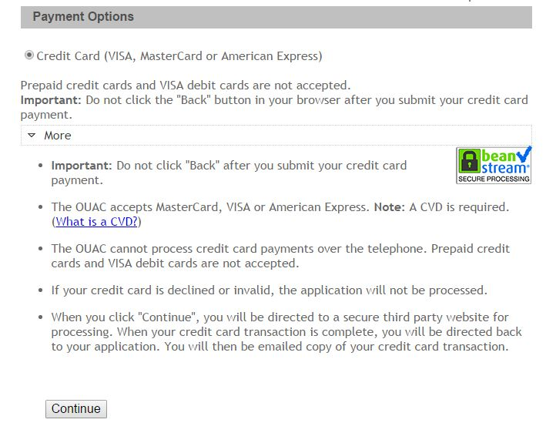
Paying for Your Application
Once you choose your method of payment and click “Continue”, you will receive your OUAC Reference Number.
The OUAC cannot process your application without the application fee.
Notes:
To fully submit the application, the student must click the “Continue” button at the bottom of the payment screen.
The OUAC accepts VISA, MasterCard and American Express for application fee payments. The student should review his or her credit card number and expiry date carefully before submitting payment. Credit card receipts will be emailed immediately.
If the student chooses to pay using online banking, the OUAC will provide a bill payment account number once the completed application is submitted. The student will require this bill payment account number to submit their payment. The OUAC’s bill payment name is “Ontario Universities’ Application Centre” (or an abbreviated version of this name). Applications will not be processed or distributed until the application processing fee and any applicable additional fees are received. All payments must arrive within two weeks of submitting the application electronically. If payment arrives after the two-week grace period, the date on which the payment is received will be considered the date that the application was submitted.

Slide 21
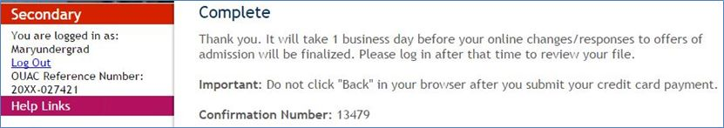
Finishing
On the “Complete” page, print the screen displaying your OUAC Reference Number (2018-XXXXXX) and further instructions. You will also receive an email.
Store your OUAC Reference Number, as you will need to include this number when communicating with the OUAC and the universities.
OUAC Reference Number: 2018-1234567
Notes:
Immediately after submitting the completed application, the student's OUAC Reference Number and further instructions will be displayed on-screen. Students should print this screen and cite their OUAC Reference Number whenever they communicate with the OUAC or the universities.
Students can view and/or make changes to their submitted 101 Online Application by logging in to their application account at: www.ouac.on.ca/ouac-101. The ability to view and/or make changes will be available 1 business day after the application is submitted and the application fee payment is received and processed.

Slide 22
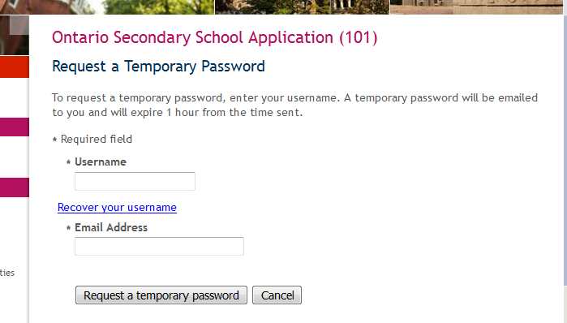
Request a Temporary Password
Notes:
If a student forgets their OUAC Profile password, they can request a temporary password by clicking “Request a temporary password” on the “Log In” screen. Students must enter their OUAC Profile username and email address. A temporary password will be emailed to them and will expire one hour from the time sent.

Slide 23
Need Assistance?
Read the " FAQ" section and the 101 Application Guide on our website at: www.ouac.on.ca/faq-application/101/.
Contact us:
OUAC
170 Research Lane
Guelph ON N1G 5E2
Telephone: 519-823-1063
Fax: 519-823-5232
Website: www.ouac.on.ca/ouac-101
Notes:
Help with the online application is available in a number of places, including the “FAQs” link on our website, the “Help” screens within the application and the Applicant Services Support Desk. Students should also refer to the 101 Application Guide available online, for university program code information and other details.
They should also visit eINFO at: www.electronicinfo.ca.

