Slide 1
ST. JOHN’S COLLEGE GRADUATION
JUNE 27, 2024

Slide 2
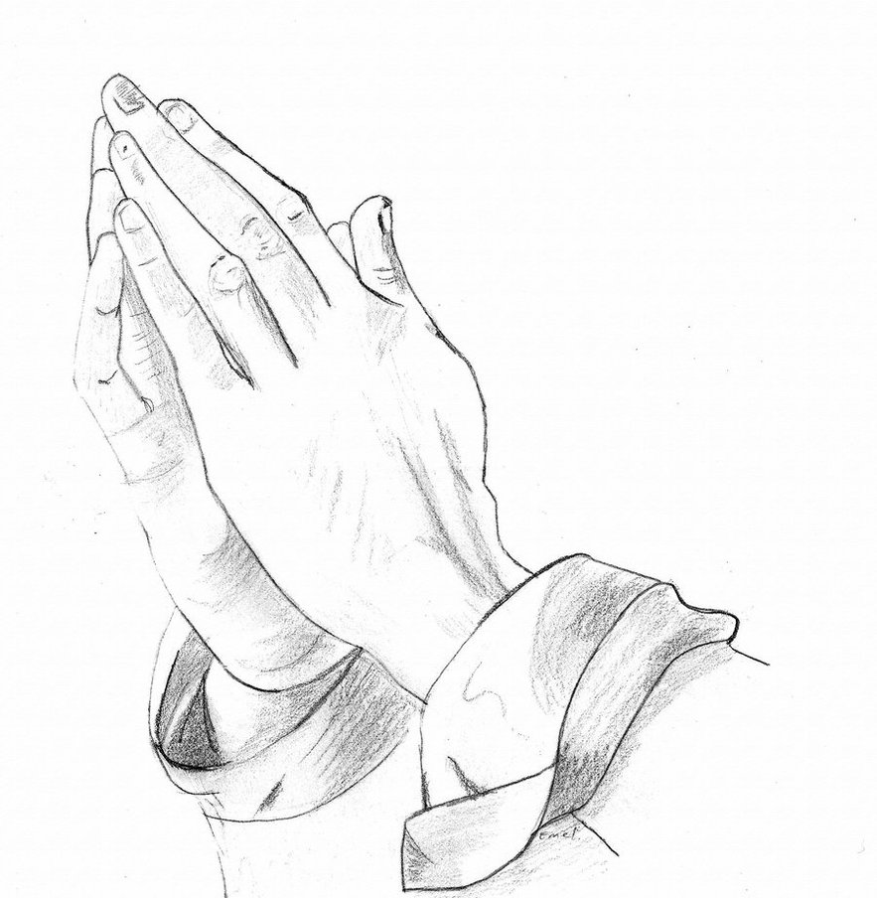
PRAYER Dear God, as we face this last year of high school, bless each of us with strength and enthusiasm, may we tackle this year with energy and a strong commitment to succeed. May we each do our personal best, giving all we can give. Lastly, we pray for the guidance of the Holy Spirit. May all our decisions be well thought out, filled with good counsel, and open to the guidance of the Holy Spirit. Amen.

Slide 3
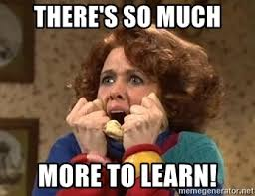

Slide 4
PLEASE NOTE: UPCOMING IMPORTANT DATES:
Grad Activity | Date
ONLINE GRADUATION FEE PAYMENT & GRAD APPLICATION FORM *School Cash Online *does NOT include fee for Retreat or Prom tickets | Oct. 31, 2023
VALEDICTORIAN NOMINATION FORMS due to Mr. MacKinlay by 3:00pm | Dec. 8, 2023
GRAD PHOTOS *Edge Imaging Flyer will be emailed out once grad fee/form are completed *see Mrs. Ronson in Student Services if you have any questions* | Jan. 9 - 19, 2024
VALEDICTORIAN NOMINATION ESSAYS *due to Mr. MacKinlay by 3:00 pm | Jan. 12, 2024
VALEDICTORIAN VOTE *online voting (for 24 hours) through Election Buddy & school email account | Mar. 6, 2024
GRAD PHOTOS RE-TAKES | Feb. 26 & 27, 2024
APPLICATIONS FOR SJC AWARDS/BURSARIES/SCHOLARSHIPS *due by 3:00pm **NEW format this year | Feb. 28, 2024
GRAD RETREAT *organized by Chap Andy | Apr. 26, 2024
HONOUR J / EAGLE AWARD APPLICATIONS *due by 3:00pm | Apr. 30, 2024
PROM TICKET SALES *paid through School Cash Online **grad fee does NOT cover prom ticket costs | Apr. 29, 30, May 1, 2, 3, 2024
GRAD FEE REFUND DEADLINE *if you choose not to participate | May 1, 2024
SENIOR PROM @ Best Western 5:45 – 10:00pm **tentative date | May 31, 2024
GRAD REHEARSAL @ Sanderson Centre 9:00 am – 12:00 pm *mandatory* | June 26, 2024
GRADUATION CEREMONY @ Sanderson Centre 7:00 pm | June 27, 2024

Slide 5
FULL DISCLOSURE
Full disclosure dates for this
school year are:
SEMESTER 1: December 1, 2023
SEMESTER 2: May 9, 2024
In order to ensure a course does not appear on your transcript from the semester you are working in, you must drop the course PRIOR to the FULL DISCLOSURE dates outlined above.

Slide 6
VALEDICTORIAN CANDIDATES
Must submit a Valedictorian Nomination Form to Mr. MacKinlay by December 8, 2023 *found in your Leaving the Nest Assembly package or at sjconline
A 300-word essay on ‘Why You Are A Worthy Candidate & How You Meet the Valedictorian Criteria’ is due by 3:00 pm on January 12, 2024
The Grad Committee will confirm up to 5 candidates
Candidates will be given an opportunity to present their essay on morning announcements over SJC-TV for a 1 minute/20 second segment on
March 5, 2024 & will appear in alphabetical order
Candidate names will be put on the ballot in alphabetical order
Voting ballots will be completed online for 24 hours beginning at 8am on March 6, 2024

Slide 7
VALEDICTORIAN VOTING PROCEDURE
Must be a potential grad, who is participating in the graduation ceremony at the Sanderson Centre & has paid the grad fees
Date for Voting: March 6, 2024 (online voting window is open for 24 hours beginning at 8am on March 6th and ending at 8am on March 7th)
Voting will be done online through ‘Election Buddy’. You must ensure you check your school email account.

Slide 8
AWARDS, BURSARIES AND SCHOLARSHIPS
Take the time to research the Awards/Bursaries/Scholarships
There is different criteria for each, so be sure to do your research and see which ones apply to you
Take the time to complete the applications and submit them by the deadline
New format this year; application will be done with Microsoft Forms; all required documents will be uploaded and the student will submit the application package digitally

Slide 9
PRINCIPAL’S HONOUR ROLL CRITERIA
Students who qualify for ‘Principal’s Honour Roll’ must achieve:
80% average in a minimum of 6 courses and be recognized as a full-time student (September – June mandatory 6 courses)
Average is calculated with BEST SIX courses taken in the Gr. 12 school year including summer school courses (offered by our board) taken the summer prior to beginning Gr. 12, as well as any e-learning courses taken through PRISM
Must have completed your Gr.12 Religion course to be eligible
Averages are calculated using ONLY courses taken with BHNCDSB
Courses completed with another board would NOT be eligible towards the Principal’s Honour Roll
Courses completed with outside online platforms including, but not limited to: Blyth Academy, ilc.org, Ontario Virtual High school etc. would NOT be eligible towards Principal’s Honour Roll

Slide 10
GRADUATION RETREAT
Location: Marydale Park in Hamilton
Date: April 26, 2024
Organizer: Chap Andy
*More details to follow in the new year.

Slide 11
GUEST PASSES FOR THE GRADUATION CEREMONY @ SANDERSON CENTRE
Last year we gave each graduate 3 guest passes for the Graduation Ceremony. At this time, the number of guest passes that will be given to each grad is unknown. We should have a firm number of graduating students by the end of May 2024 and the number of guest passes will be determined around this time. *However, our graduating classes are growing in size and preliminary numbers indicate that we will only have enough room for 2 guest passes for each graduate.
The best way to get an extra ticket is to NETWORK with other students.
There may be the possibility for a Lottery for one extra guest pass, but that will not be determined until early June.

Slide 12
COMMUNITY SERVICE HOURS
DUE DATE:
40 HOURS OF COMMUNITY SERVICE MUST BE HANDED IN TO
STUDENT SERVICES NO LATER THAN:
January 31, 2024

Slide 13
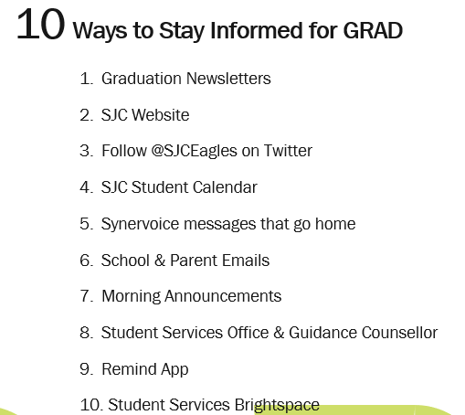

Slide 14
Synervoice Messages & Contact Information
Throughout the school year I will be sending home numerous phone SYNERVOICE messages. Listen to them.
The longer Synervoice messages will be sent home by phone AND email.
It is CRITICAL that your parent/guardian ensures the office has the correct cell #s and email addresses or they will miss these important messages.
If you don’t have or use a landline, then please update the office with the cell numbers to be contacted at.
Once you turn 18 – if you DO NOT SIGN & RETURN a consent form for your parents to receive phone calls or any type of communication from the school then THEY WON’T. All the information will go to you – your school email and a cell # (if you provided it).
This piece is so important to stay informed with grad information like grad photos, guest passes, grad package pick-up dates and grad rehearsal and grad ceremony information.

Slide 15
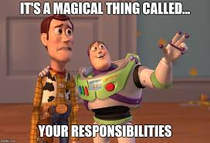

Slide 16
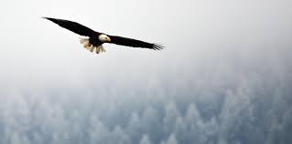
Finish Strong!

